Slide 1
Chatbot Banking
- By Jyoti Karmakar

Slide 2
1. Problem
“Me: What are your opinions about intolerance in India? Girl: I have a boyfriend Me: Please tell me about the intolerance in India? SBI staff: Lunch ke baad aana.(come after Lunch)”
Well This Joke tells a lot about the Issues of Offline Banking . Lets look into deep about some problems of Current Banking.

Slide 3
Online Banking
(Net Banking , IVR)
Offline Banking
Visit Branch
Time Consuming.
Travel needed.
Client Interaction is totally dependent on representatives mood.
Impatience for long conversation.
Self Dependent. Less Assistance.
Knowledge of the portal, process or Banking Terms/Jargons required.
In IVR each time a new representatives answers so each Time a lot of information needed to introduce the user.
Less user interactivity.
Currently users are more active on other platform like Social media, messengers
Notes:
Some users don’t know or remember the exact term(word) or may even can’t explain properly what they want.
Sometimes user prefer non-human interaction because of security, harassment, they may not able to explain properly due to lack of Banking Knowledge and the representative is not so friendly.

Slide 4
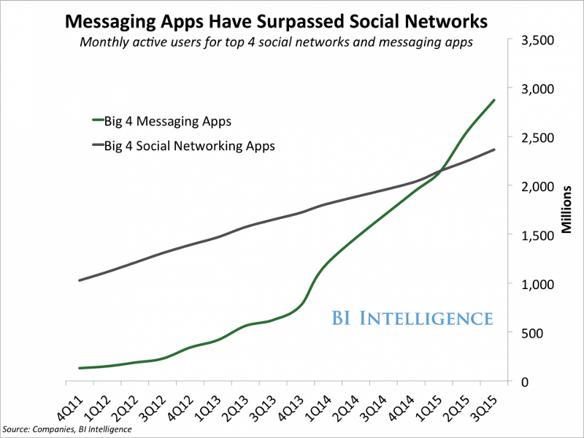
2. Solution
If you want to build a business online, you want to build where the people are. That place is now inside messenger apps.
For the first time ever people are using messenger apps more than they are using social networks.

Slide 5
Overcome the Existing issues
No Branch Visit .
Less Time Consuming.
The bot’s behaviour and interaction can be controlled programmatically.
Instant Assistance.
Less knowledge of the platform , process or Banking Terms/Jargons required(*).
Bot can remember the user identity unlike the IVR issue.
Notes:
* with the use of Chatbot we can easily understand what exactly what user wants by asking repeated questions if he did not know the exact Terms/Jargons.

Slide 6
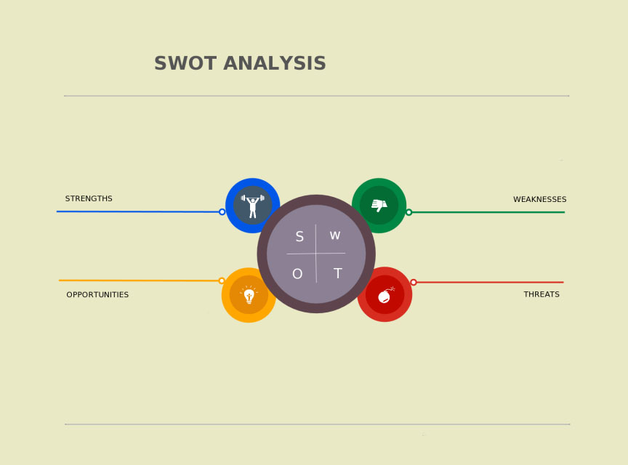
3. Analysis and Validation
Interactive.
Less Time Consuming.
One Time Identity Needed.
Use for Promotions.
Knowledge of User Behaviour
Less Secure then Offline.
Complexity
Device and Online Dependency
Improve Security using biometric.
Grabbing quick Attraction.*
Breaking the data while Device Stolen
Notes:
*It’s potentially a huge business opportunity for anyone willing to jump headfirst and build something people want.
Be the first to reach in your Domain Or learn the Technology

Slide 7
4.Overcoming the Weakness and Threats.
Many Organization has overcome this weaknesses and already implemented their Chatbot . Secure Financial foundations like American Express have their chatbots.(List of existing chatbots https://botlist.co/bots/filter?category=29&platform=13)
We can learn from existing platform and improve the future product.
We can improve the areas like Security, UI, Functionality learnings from the Developer Docs like
https://developers.facebook.com/products/messenger/
https://api.ai/
https://api.slack.com/bot-users

Slide 8
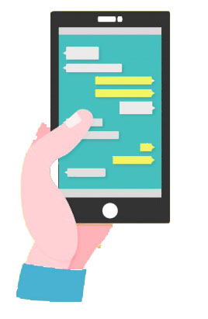


Security Implementation
As the analysis the biggest challenge is security.
The biometric is currently not available or many devices.
The issue can be resolved by following approach.
Stores Encrypted Data
Stores Encryption Key.
On chat history show only less secure data . And for secure data ask Magic word or security token. Like most net banking needed two password 1)Banking password and 2)Transaction password.

Slide 9

Logical and Performance Implementation
Work in Progress.
Back Soon...

Slide 10
FAQ
1. Why should I prefer it before the Offline Process that have Human Interaction?
2. Security?
3. Can use for Promotions, Offers?
4. Use it for only Account Opening or for other banking Functionalities?
5. FB is social application how its related to BFS Chatbot?

Slide 11
Useful Links
The Complete Beginner’s Guide To Chatbots.(https://chatbotsmagazine.com/the-complete-beginner-s-guide-to-chatbots-8280b7b906ca#.jxb14a2p5)
https://yourstory.com/2016/05/chatbots-startups-india/
https://yourstory.com/2016/06/product-launches-startup-week-june-1/
Chatbot Tutorial(http://www.codeproject.com/Articles/36106/Chatbot-Tutorial)
https://www.google.com/patents/US8250192

